Slide 1
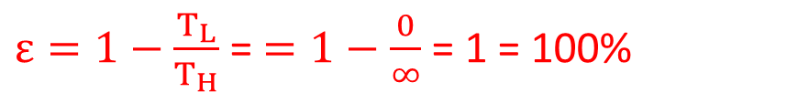
Lecture 12
Chapter 20: Entropy and the second law of thermodynamics
20-2 No Perfect Engines:
Inventors continually try to improve engine efficiency by reducing the energy Q_{L} that is “thrown away” during each cycle. The inventor’s dream is to produce the perfect engine, diagrammed in Fig, in which Q_{L} is reduced to zero and Q_{H} is converted completely into work.
Also, a perfect engine is only a dream: impossible requirements
$ε=1−\frac{T_{L}}{T_{H}}$ = $=1−\frac{0}{∞}$ = 1 = 100%
Instead, experience gives the following alternative version of the second law of thermodynamics, which says in short, there are no perfect engines:
“No series of processes is possible whose sole result is the transfer of energy as heat from a thermal reservoir and the complete conversion of this energy to work”.

Slide 2
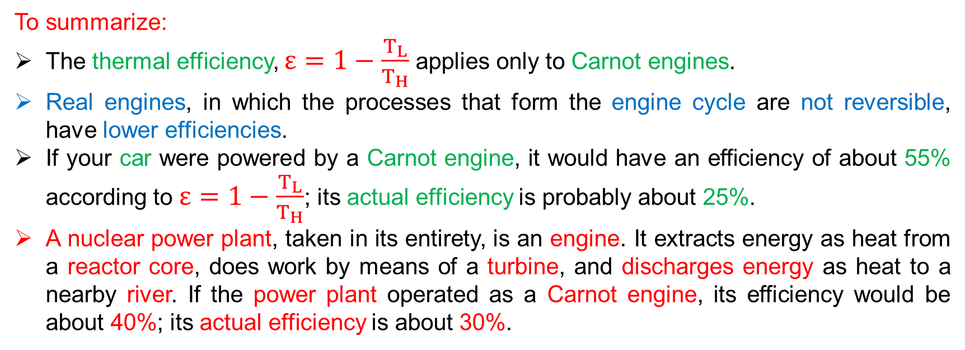
To summarize:
The thermal efficiency, $ε=1−\frac{T_{L}}{T_{H}}$applies only to Carnot engines.
Real engines, in which the processes that form the engine cycle are not reversible, have lower efficiencies.
If your car were powered by a Carnot engine, it would have an efficiency of about 55% according to $ε=1−\frac{T_{L}}{T_{H}}$; its actual efficiency is probably about 25%.
A nuclear power plant, taken in its entirety, is an engine. It extracts energy as heat from a reactor core, does work by means of a turbine, and discharges energy as heat to a nearby river. If the power plant operated as a Carnot engine, its efficiency would be about 40%; its actual efficiency is about 30%.

Slide 3


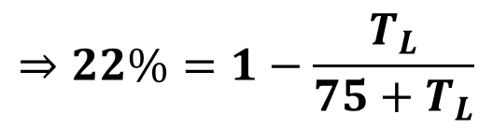
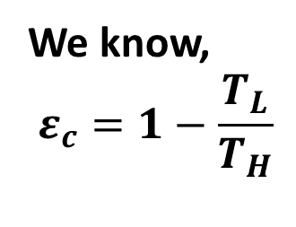

25. A Carnot engine has an efficiency of 22.0%. It operates between constant-temperature reservoirs differing in temperature by 75.0 C⁰. What is the temperature of the (a) lower-temperature and (b) higher-temperature reservoir?
Given,
Efficiency, $ε_{c}=22.0\%=0.22$
Difference in temperature, $T_{H}−T_{L}={75C}^{0}=75 K$
$${(T}_{H}+273)−{(T}_{L}+273)=75K$$
$$\left(a\right) T_{L}=?$$
We know,
$$ε_{c}=1−\frac{T_{L}}{T_{H}}$$
$$⇒22\%=1−\frac{T_{L}}{75+T_{L}}$$
$[as T_{H}=75+T_{L}$]

Slide 4

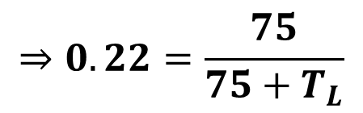

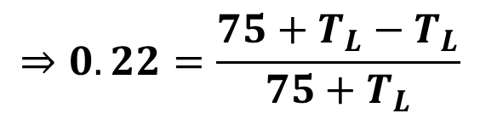




$$⇒0.22=\frac{75+T_{L}−T_{L}}{75+T_{L}}$$
$$⇒0.22=\frac{75}{75+T_{L}}$$
$$⇒0.22(75+T_{L})=75$$
$$∴T_{L}=266 K$$
$$\left(b\right){ T}_{H}= ?$$
We have,
$$T_{H}−T_{L}=75 K$$
$$T_{H}−266=75$$
$$∴T_{H}=341 K$$

Slide 5


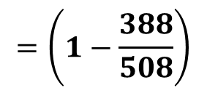
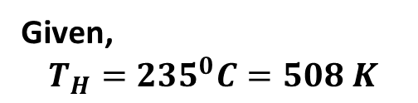
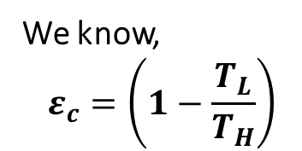


27. A Carnot engine operates between 235 ⁰C and 115 ⁰C, absorbing 6.30x10⁴ J per cycle at the higher temperature. (a) What is the efficiency of the engine? (b) How much work per cycle is this engine capable of performing?
Given,
$$T_{H}={235}^{0}C=508 K$$
$$T_{L}={115}^{0}C=388 K$$
$$Q_{H}=6.3×{10}^{4} J$$
$${\left(a\right) ε}_{c}=?$$
We know,
$$ε_{c}=\left(1−\frac{T_{L}}{T_{H}}\right)$$
$$=\left(1−\frac{388}{508}\right)$$
$$=0.2362=23.62\%$$

Slide 6
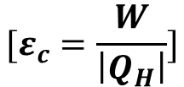
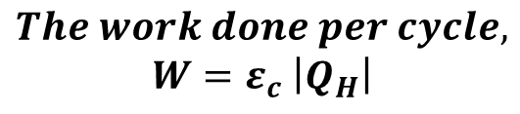


$$The work done per cycle,$$
$$W=ε_{c} \left|Q_{H}\right|$$
$$[ε_{c}=\frac{W}{\left|Q_{H}\right|}]$$
$$=0.2362 ×(6.3×{10}^{4})$$
$$W=1.48×{10}^{4} J$$

